Slide 1
EVERYTHING I NEED TO KNOW ABOUT DEBUGGING I LEARNED IN ELEMENTARY PHYSICS
#DebuggingPhysics

Slide 2
PHYS 23: Weed-Out Course

Slide 3
WHAT’S WRONG WITH THIS SCENE?

Slide 4
FIRST TEST

Slide 5

GRADERS

Slide 6
Bundle of Nerves was an Understatement

Slide 7
But Wait! There’s More

Slide 8
YOU WON’T GET AWAY WITH THAT IN…
Middle School
High School
College

Slide 9
But Wait! There’s More

Slide 10

WHAT IT LOOKED LIKE

Slide 11

WHAT IT FELT LIKE

Slide 12
FOUR STEPS
Labeled Diagram
What’s Known
What’s Unknown
Starting Equation

Slide 13
The steps moved the problem from impossible, to achievable

Slide 14
An airplane accelerates down a runway at 3.20 m/s^2 for 32.8s until it finally lifts off the ground. Determine the distance traveled before takeoff.
http://www.physicsclassroom.com/Class/1DKin/U1L6d.cfm

Slide 15
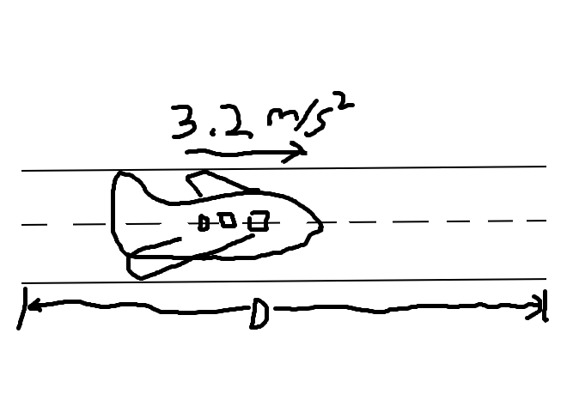
DRAW A PICTURE

Slide 16
WHAT’S KNOWN?

Slide 17
An airplane accelerates down a runway at 3.20 m/s^2 for 32.8s until it finally lifts off the ground. Determine the distance traveled before takeoff.
http://www.physicsclassroom.com/Class/1DKin/U1L6d.cfm

Slide 18
WHAT’S KNOWN?
Acceleration: 3.2m/s²

Slide 19
An airplane accelerates down a runway at 3.20 m/s^2 for 32.8s until it finally lifts off the ground. Determine the distance traveled before takeoff.
http://www.physicsclassroom.com/Class/1DKin/U1L6d.cfm

Slide 20
WHAT’S KNOWN?
Acceleration: 3.2m/s
Time: 32.8s

Slide 21
WHAT’S UNKNOWN?

Slide 22
An airplane accelerates down a runway at 3.20 m/s^2 for 32.8s until it finally lifts off the ground. Determine the distance traveled before takeoff.
http://www.physicsclassroom.com/Class/1DKin/U1L6d.cfm

Slide 23
WHAT’S UNKNOWN?
Distance

Slide 24
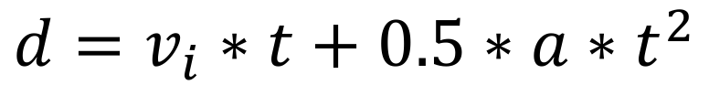
STARTING EQUATION
$$d=v_{i}∗t+0.5∗a∗t^{2}$$

Slide 25






SOLVING THE PROBLEM
$$d=v_{i}∗t+0.5∗a∗t^{2}$$
$v_{i}$ = 0 m/s
$t$ = 32.8s
$$a=3.2 m/s^{2}$$
$$d=0∗t+0.5∗3.2∗{32.8}^{2}$$
$$d=1077.44m$$

Slide 26
You just solved a physics problem!

Slide 27
FOUR STEPS
Labeled Diagram
What’s Known
What’s Unknown
Starting Equation

Slide 28
Applying to Software

Slide 29
Anyone Ever Anxious When Fixing Bugs?

Slide 30

TPS Reports

Slide 31
TPS REPORTS STANDUP

Slide 32

NEGATIVE VOICE
Are you still working on that?

Slide 33

ANOTHER NEGATIVE VOICE
What’s taking you so long?

Slide 34

YET ANOTHER NEGATIVE VOICE
Isn’t it just ____ ?

Slide 35
No? Just me?

Slide 36
Let the steps move the bug from impossible, to achievable

Slide 37
When displaying the registration form, instead of showing “First Name” for the label, it shows “registration.firstName”

Slide 38

DRAW A PICTURE

Slide 39
WHAT IS KNOWN
Should Show:
First Name
Using Localized String
Is Showing: translation key

Slide 40
WHAT’S UNKNOWN?
Is the Value Specified?

Slide 41
Starting Location: Translations File

Slide 42

PROBLEM

Slide 43

SOLUTION

Slide 44

PROBLEM SOLVED

Slide 45
Sometimes It’s Not That Simple

Slide 46
A plane has a takeoff speed of 88.3 m/s and requires 1365 m to reach that speed. Determine the acceleration of the plane and the time required to reach this speed.
http://www.physicsclassroom.com/Class/1DKin/U1L6d.cfm#q18

Slide 47
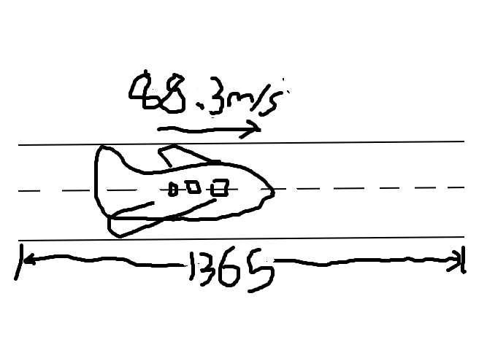
DRAW A PICTURE

Slide 48
A plane has a takeoff speed of 88.3 m/s and requires 1365 m to reach that speed. Determine the acceleration of the plane and the time required to reach this speed.
http://www.physicsclassroom.com/Class/1DKin/U1L6d.cfm#q18

Slide 49
WHAT’S KNOWN?
Final Velocity: 88.3m/s
Distance: 1365m

Slide 50
A plane has a takeoff speed of 88.3 m/s and requires 1365 m to reach that speed. Determine the acceleration of the plane and the time required to reach this speed.
http://www.physicsclassroom.com/Class/1DKin/U1L6d.cfm#q18

Slide 51
WHAT’S UNKNOWN?
Acceleration
Time

Slide 52
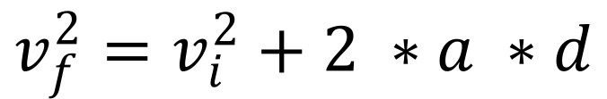
STARTING EQUATION
$$v_{f}^{2}=v_{i}^{2}+2 ∗a ∗d$$

Slide 53






SOLVING FOR $a$
$$v_{f}^{2}=v_{i}^{2}+2 ∗a ∗d$$
$v_{i}$ = 0 m/s
$v_{f}$= 88.3m/s
$$d=1365m$$
a $=$ $v_{f}^{2}$/ $2∗d$
$$a=2.8m/s^{2}$$

Slide 54

STARTING NEXT EQUATION
$$v_{f}=v_{i}+a∗t$$

Slide 55






SOLVING FOR $t$
$$v_{f}=v_{i}+a∗t$$
$v_{i}$ = 0 m/s
$v_{f}$= 88.3m/s
$$a=2.8m/s^{2}$$
t $= \frac{v_{f}−v_{i}}{a}$
t = 30.9s

Slide 56
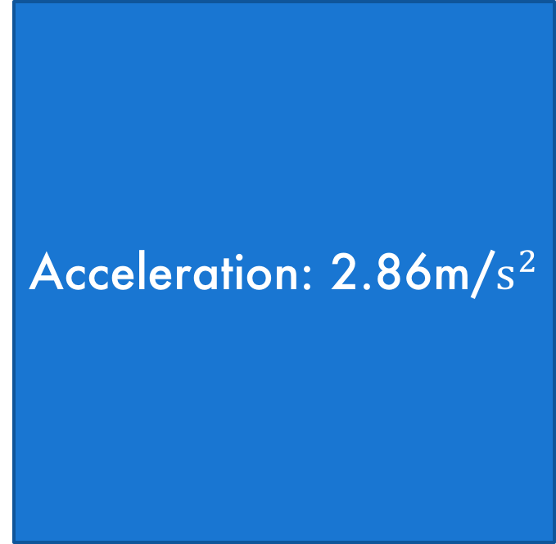
ANSWER
Acceleration: 2.86m/$s^{2}$
Time: 30.9s

Slide 57
You just solved another physics problem!

Slide 58
More Complicated Bug

Slide 59
When I’m on the import page for store 3, and click import, I’m seeing records for store 28

Slide 60
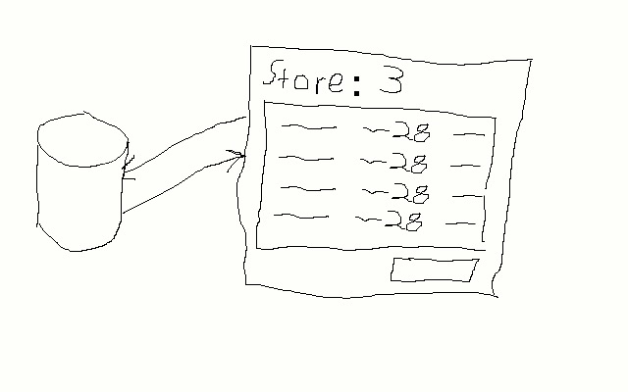
DRAW A PICTURE

Slide 61
When I’m on the import page for store 3, and click import, I’m seeing records for store 28

Slide 62
WHAT’S KNOWN
On Store 3
Seeing Store 28

Slide 63
WHAT’S UNKNOWN?
What’s the Request?
What’s the Response?

Slide 64
STARTING EQUATION
Examine the Request

Slide 65
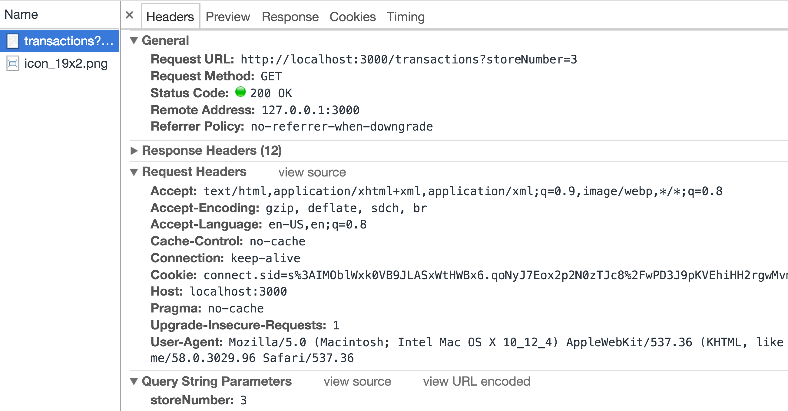
REQUEST BODY

Slide 66
A NEW KNOWN
On Store 3
Seeing Store 28
Request Sends Id 3

Slide 67
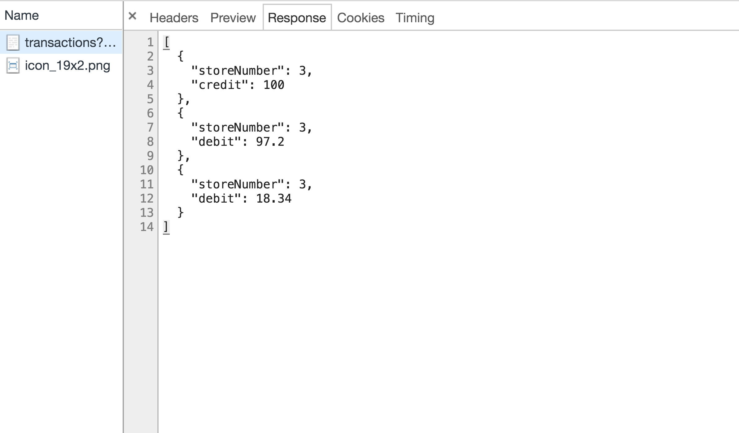
RESPONSE

Slide 68
YET ANOTHER KNOWN
On Store 3
Seeing Store 28
Requesting ID 3
Returning ID 3

Slide 69
UPDATE PICTURE
3
3

Slide 70
A NEW UNKNOWN
What’s the Request?
What’s the Response?
How is the Response Used?

Slide 71
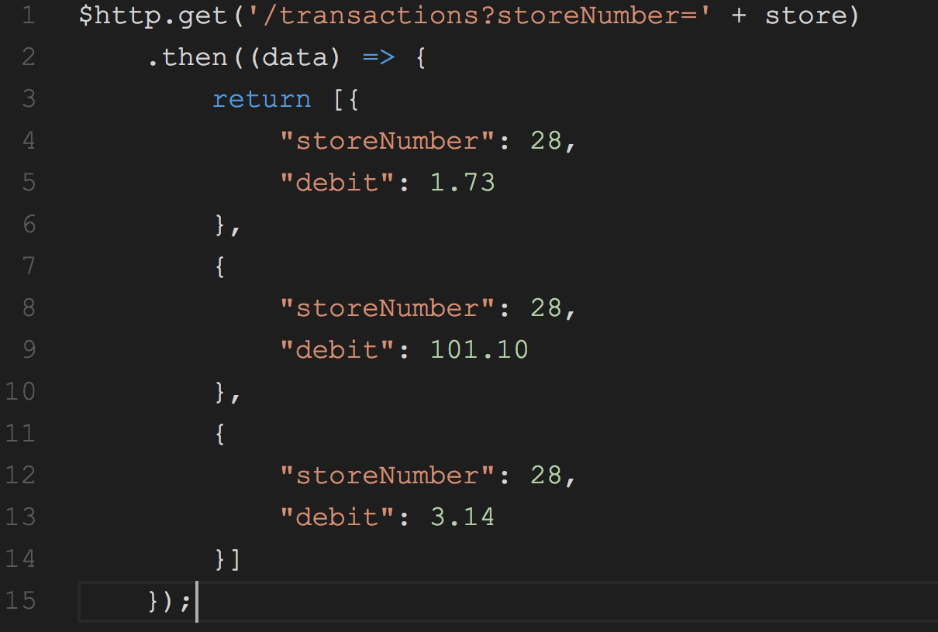

Slide 72
Don’t Hard Code Results

Slide 73
You Try

Slide 74
Roman Numeral Math

Slide 75
Can’t Use Numbers

Slide 76
To the Code

Slide 77
Additional Tips

Slide 78
Write It Out

Slide 79
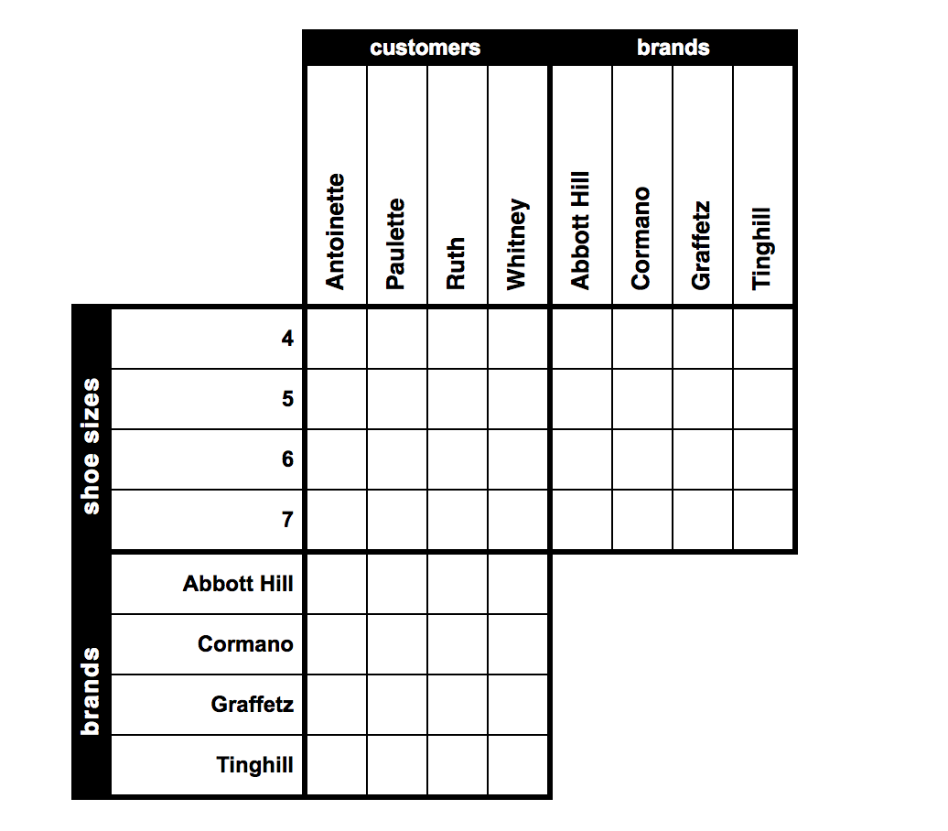
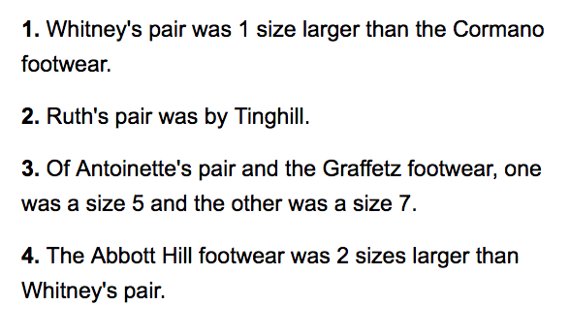
VERIFY YOUR KNOWNS & UNKNOWNS

Slide 80
ASK QUESTIONS TO CREATE A HYPOTHESIS
Notes:
For example, is it only store 3 that shows 28, or do all stores show 28?
Is it always store 28 that shows, or does it change?

Slide 81
BEWARE OF TOO MUCH DATA

Slide 82
tl;dr

Slide 84
There is ONE Time This Should Happen

Slide 85
WHEN IN DOUBT, FOLLOW THE STEPS
Labeled Diagram
What’s Known
What’s Unknown
Starting Equation

Slide 86
The steps will move the bug from impossible, to achievable

